Slide 1

Cryptographic Algorithms
Made by: Angelo Pelham, John Simmons, Shanysse Alexander, Muhammed Zaid

Slide 2
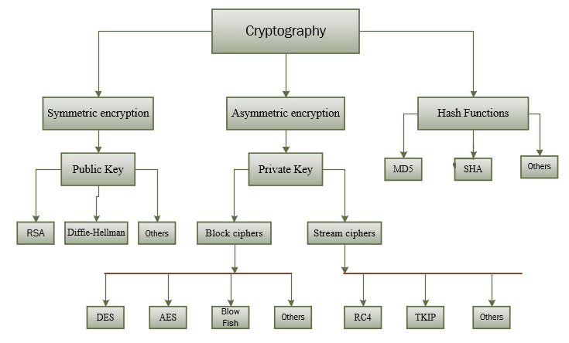
The Cryptographic algorithms
Cryptographic algorithms are algorithms that secure data by using various methods of calculations. All these algorithms are computer based as of today but before then machines were used to conduct these calculations. These algorithms use mathematics to turn text/messages into an unreadable outcome. This is used on not just data encryption but also authentication and signatures. There are 3 cryptographic algorithms Hash, asymmetric key, and symmetric key.

Slide 3
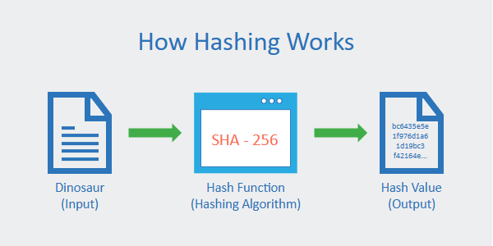
Hash algorithms
Hash Algorithms are a form of Cryptography that uses a function to take data and make it unreadable. The difference between Hash Algorithms and some of the others is that the data remains unreadable and can’t be decoded to uncover the message. An example of one Hash Algorithm would be One way which alters the original state of the data once it transitions through the algorithm. Hash algorithms take a message or text and run it through the algorithm that starts to hash the message. When completed it can be either shared or stored. Hashing is incredible vital to keeping information stored at rest while still maintaining security. Often used to make sure that the original data contents have not changed when files are transferred.

Slide 4
SYMMETRIC ALGORITHMS
Symmetric key algorithms are a type of cryptographic technique that uses a shared secret key for both encryption and decryption.
To communicate securely, both the sender and the recipient of a message must possess the same secret key.
Symmetric key algorithms are faster and more efficient than asymmetric key algorithms
Since they can quickly encrypt and decode data, they are ideal for applications like protecting internet communication.
While symmetric key algorithms are generally faster and more efficient than asymmetric key algorithms, they are also less secure.
This is because the same key is used for both encryption and decryption, which means that if the key is compromised, the security of the entire system is compromised.

Slide 5
STRENGTHS OF SYMMETRIC ALGORITHMS
Key size - The larger the key size, the stronger the algorithm.
Block size - The larger the key size, the stronger the algorithm.
Resistance to attacks − The resistance of a symmetric key algorithm to attacks, such as brute-force attacks algorithms that are resistant to these types of attacks are generally considered to be stronger.

Slide 6
Asymmetric algorithms
An asymmetric algorithm also known as a public key system uses two keys instead if one. It is when one key is used to encipher the data and the other key that corresponds is used to decipher the data.
The two keys are known as private and public keys. The key that’s used to decipher the data is a secret while the key that’s used to encipher the data is known and can be freely distributed.
The Rivest Shamir Adelman (RSA) is a public key algorithm that was published in 1977 and became the basis for multiple products.
The Elliptic curve digital signature algorithm (ECDSA) uses elliptic curve cryptography to make a variant of the digital signature algorithm.
The digital signature standard public key algorithm uses its private key to generate a digital signature and the uses its public keys to verify a digital signature.

Slide 7
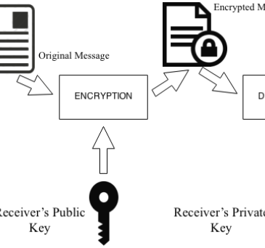
RSA Algorithm
Select two prime numbers (7,19)
Multiply them (7*19=133)
Use the following formula (7-1)*(19-1) = (108)
Find a number that 108 and it has no common positive divisor other than 1. (5)
Use the following formula (1+133*108)/5 = (2,873)
The public keys are133 and 5, and the private keys are 133 and 2,873

Slide 8
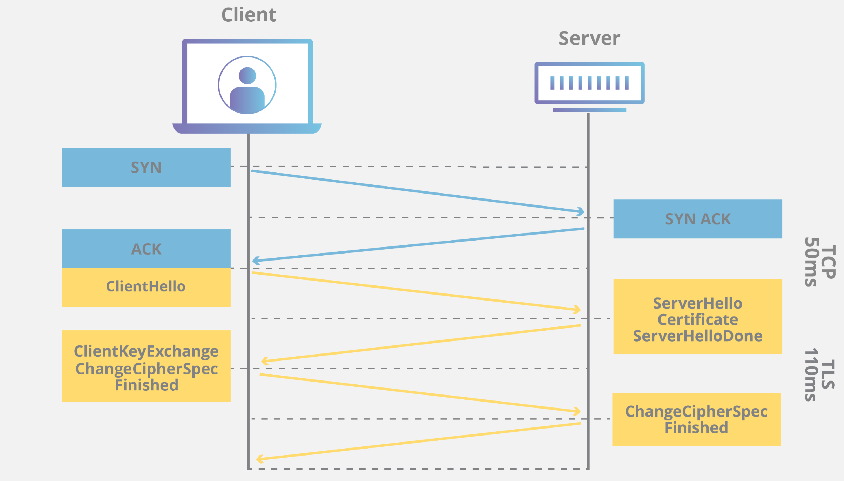
Transport layer Security
A widespread cryptographic protocol that is the replacement for SSL.
The primary use of TLS is for encrypting the communication between web applications and servers, such as web browsers loading a website.
TLS can also be used to encrypt other communications such as email, messaging, and voice-over (VoIP).
A cipher suite is a named combination of the encryption, authentication, and message authentication code (MAC) algorithms that are used with TLS and SSL. They are negotiated between the web browser and web server during the initial connection handshake.

